Slide 1
Instagram User Analytics
Trainity
Project No 2

Slide 2
Project Description
In this project extract helpful insights from row data information
Using the Structured query language (SQL) is a standard language for database creation and manipulation.

Slide 3
Approach The project was executed using sql where queries were utilized to create a database from the provided raw data sorting and data extracting queries were then implemented to obtain the required
.

Slide 4
Tech Stack used Tech stack used included MySQL Workbench v8.0.30.0 MySQL Workbench is a graphical tool for working with MySQL servers and databases
.

Slide 5
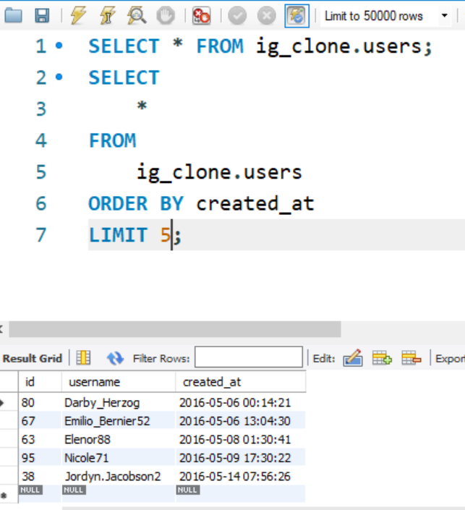
Project insights A)Marketing
The marketing team wants to reward the most loyal users, who have been using the platform for the longest time.
Conclusion
the five oldest users on Instagram from the provided database.
>>>>>>>>>>>>>>>>>>>>>>>>

Slide 6
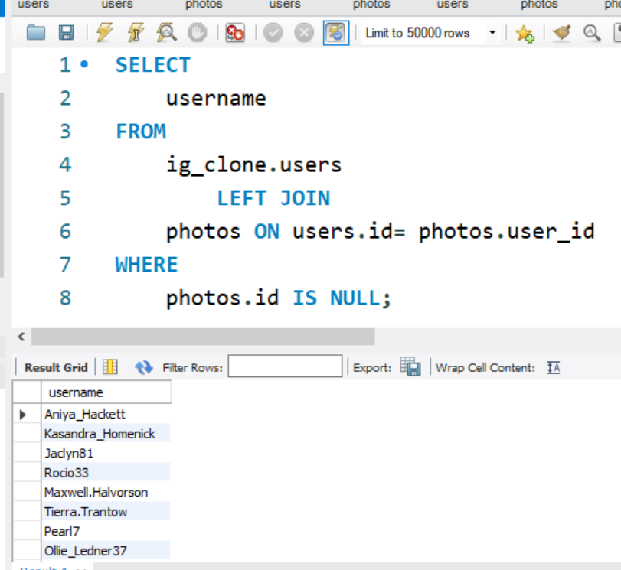
Project insights
The team wants to encourage inactive users to start posting by sending them promotional emails.
Conclusion
users who have never posted a single photo on Instagram..
>>>>>>>>>>>>>>>>>>>>>>>>

Slide 7
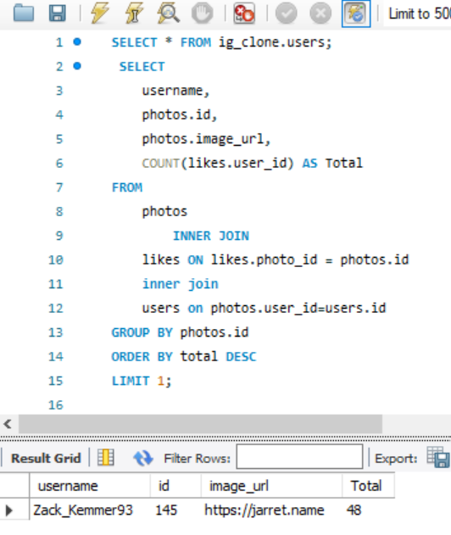
Project insights
The team has organized a contest where the user with the most likes on a single photo wins..
Conclusion
Determine the winner of the contest and provide their details to the team
>>>>>>>>>>>>>>>>>>>>>>>>

Slide 8
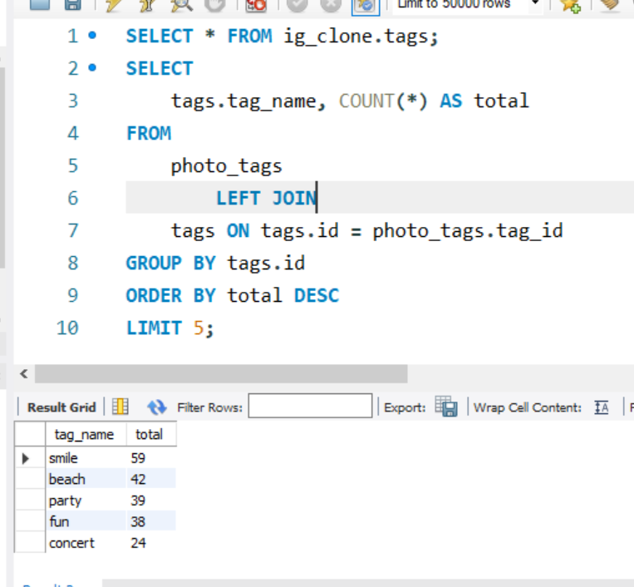
Project insights
A partner brand wants to know the most popular hashtags to use in their posts to reach the most people..
Conclusion
: Identify and suggest the top five most commonly used hashtags on the platform.
>>>>>>>>>>>>>>>>>>>>>>>>

Slide 9
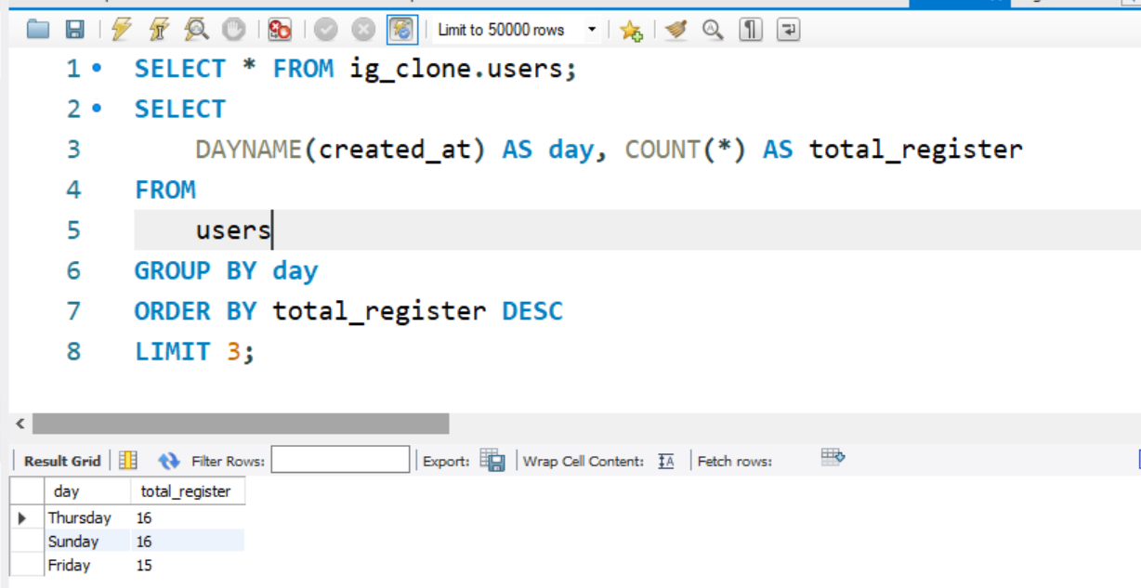
Project insights
The team wants to know the best day of the week to launch ads.
Conclusion
Determine the day of the week when most users register on Instagram. Provide insights on when to schedule an ad campaign.
>>>>>>>>>>>>>>>>>>>>>>>>

Slide 10
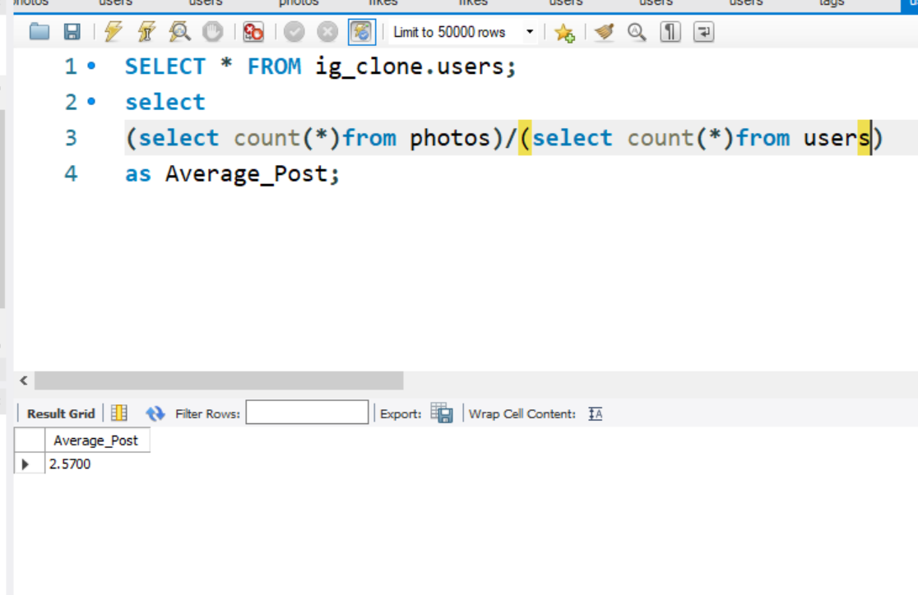
Project insights B) Investor Metrics:
Investors want to know if users are still active and posting on Instagram or if they are making fewer posts.
Conclusion
Calculate the average number of posts per user on Instagram. Also, provide the total number of photos on Instagram divided by the total number of users.
>>>>>>>>>>>>>>>>>>>>>>>>

Slide 11
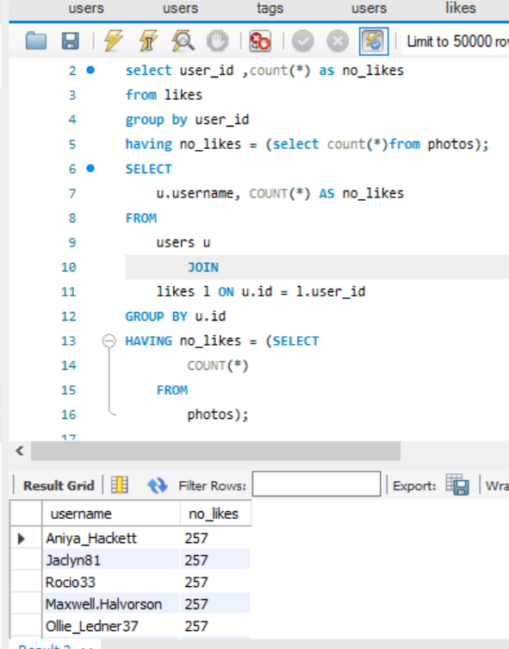
Project insights
Investors want to know if the platform is crowded with fake and dummy accounts.
Conclusion
Identify users (potential bots) who have liked every single photo on the site, as this is not typically possible for a normal user.
>>>>>>>>>>>>>>>>>>>>>>>>

